Slide 1
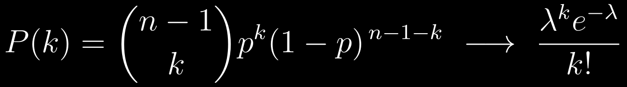
DPCN 2026 SESSION
Analytical Properties of
Erdős–Rényi Random Graphs
Phase transitions, threshold functions, and the generating-function formalism
Derived throughout from first principles · Newman, The Structure and Function of Complex Networks (2003)
1
Notes:
Roadmap: we build the entire topology of G(n,p) analytically. Every result on these 50 slides is derived, not quoted. The talk closes with the probability-generating-function formalism, which subsumes almost everything that came before.

Slide 2
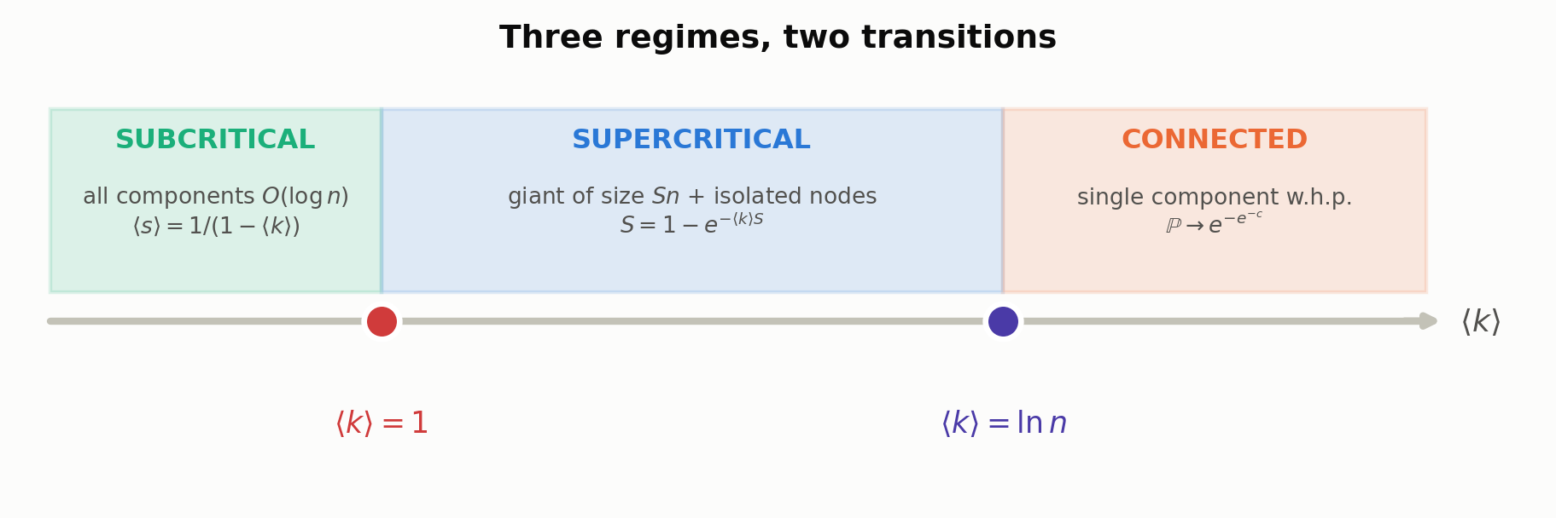
ROADMAP
Two transitions organise everything
I
Degree distribution
II
Giant component
V
Subgraph emergence
Binomial → Poisson; why ER has no hubs
S = 1 − e^(−⟨k⟩S); second-order transition
Trees before cycles; threshold ladder
Distance & clustering
IV
Connectivity
VI
Configuration model
The sharp ln n / n threshold; Chen–Stein
Molloy–Reed; scale-free epidemics
III
⟨ℓ⟩ ~ ln N / ln⟨k⟩; C = p → 0
IV
+ VII. Generating functions — the closing section
Giant-component formation (⟨k⟩ = 1) and full connectivity (⟨k⟩ = ln n) are different transitions with different mechanisms — branching versus the disappearance of isolated vertices.
2
Notes:
The single most important structural fact: two thresholds, separated by a factor of ln n. Students routinely conflate them.

Slide 3
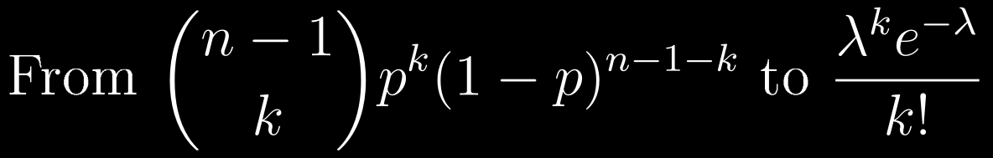
The Model and its
Degree Distribution
I
Definition of G(n,p) · the exact Binomial degree law · the Poisson limit · why random graphs cannot have hubs
I · The Model and its Degree Distribution
3
Notes:
Section I: everything follows from one modelling choice — edges are independent.

Slide 4
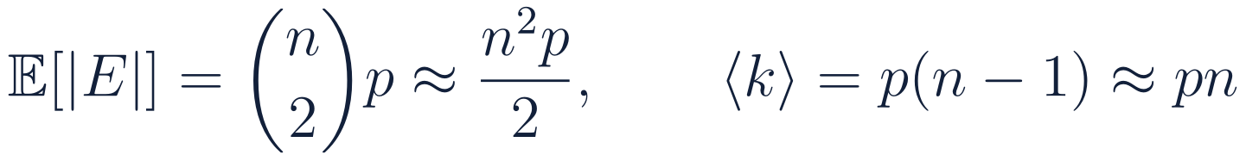
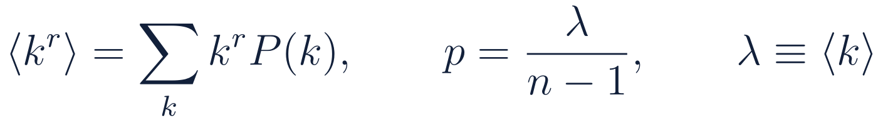
PRELIMINARIES
Definition 1.1 — the G(n,p) model
DEFINITION
EDGE COUNT AND MEAN DEGREE
NOTATION USED THROUGHOUT
Two conventions, one model
Conventions
G(n, p) — the binomial model. Each of the n(n−1)/2 pairs is joined independently with probability p. The edge count fluctuates.
G(n, M) — the uniform model. One graph drawn uniformly from all graphs with exactly M edges.
The two are asymptotically equivalent for M = p·n(n−1)/2 in the sparse regime. We use G(n,p) because independence makes every expectation factorise.
N and n are used interchangeably for the number of nodes.
“w.h.p.” — with high probability, i.e. probability → 1 as n → ∞.
Sparse regime: p = λ/(n−1) with λ = ⟨k⟩ held fixed as n → ∞. This is the only regime in which ER resembles a real network.
Dense regime p = const is combinatorially interesting but physically irrelevant: ⟨k⟩ would grow like n.
I · The Model and its Degree Distribution
4
Notes:
Independence of edges is the single assumption that produces every result in this deck — and the single reason ER fails to reproduce clustering.

Slide 5
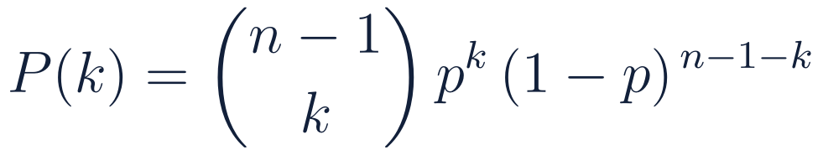
DEGREE DISTRIBUTION
The exact degree law is Binomial
Fix a node v. It has exactly n − 1 potential neighbours.
Each potential edge is an independent Bernoulli(p) trial.
Therefore deg(v) is a sum of n − 1 iid Bernoulli variables — a Binomial(n − 1, p) variable. No approximation yet: this is exact for every n and p.
Why the Binomial is not the end of the story
The Binomial coefficient is analytically unwieldy: it does not survive differentiation, convolution, or generating-function manipulation cleanly.
It carries a hard cut-off at k = n − 1 that is an artefact of finite n, not of the physics.
Real networks are sparse: p ~ 10⁻⁵ with n ~ 10⁶. The interesting limit is n → ∞ at fixed mean degree, and in that limit the Binomial collapses to a one-parameter law.
That one-parameter law is Poisson — and it is the reason every subsequent derivation in this deck closes in elementary form.
EXACT PROBABILITY MASS FUNCTION
Exact moments
Quantity | Binomial(n−1, p) | Sparse limit
mean ⟨k⟩ | (n−1)p | λ
variance | (n−1)p(1−p) | λ
⟨k²⟩ | λ² + λ(1−p) | λ² + λ
support | 0 … n−1 | 0 … ∞
I · The Model and its Degree Distribution
5
Notes:
Emphasise: the Binomial is exact, the Poisson is a limit. All later closed-form results use the Poisson form.

Slide 6
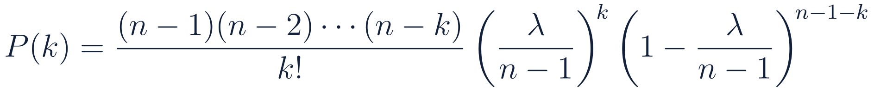
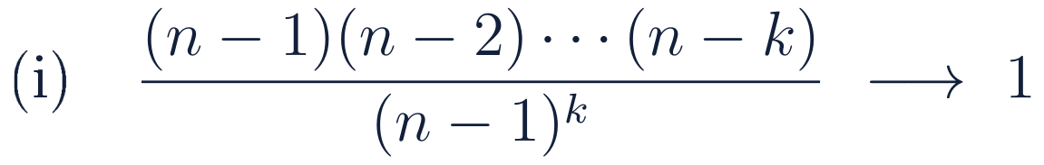
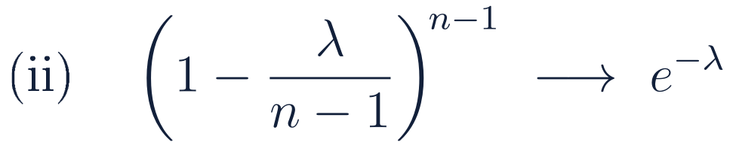
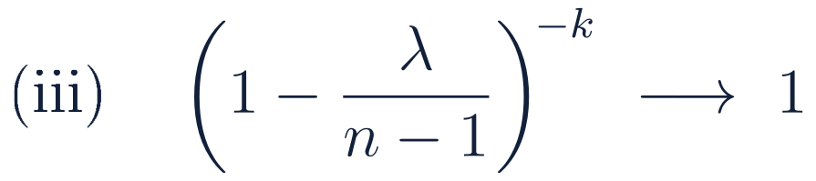
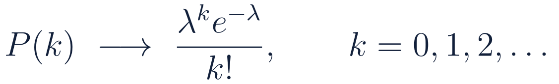

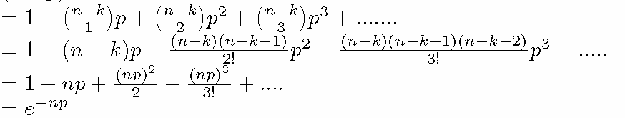
THEOREM
Derivation: the Poisson limit
Take n → ∞ holding the mean degree λ = ⟨k⟩ = p(n−1) fixed, so p = λ/(n−1) → 0.
1
Expand the coefficient
Three independent limits act on the three factors:
each of the k factors → 1 as n → ∞ (k is fixed)
the standard limit definition of the exponential
bounded exponent, base → 1
COMBINING THE THREE FACTORS
CONSEQUENCE
I · The Model and its Degree Distribution
6
Notes:
The three limits are worth writing out separately — students usually wave at 'Stirling' and miss that factor (iii) is what makes the k-dependence drop out.

Slide 7
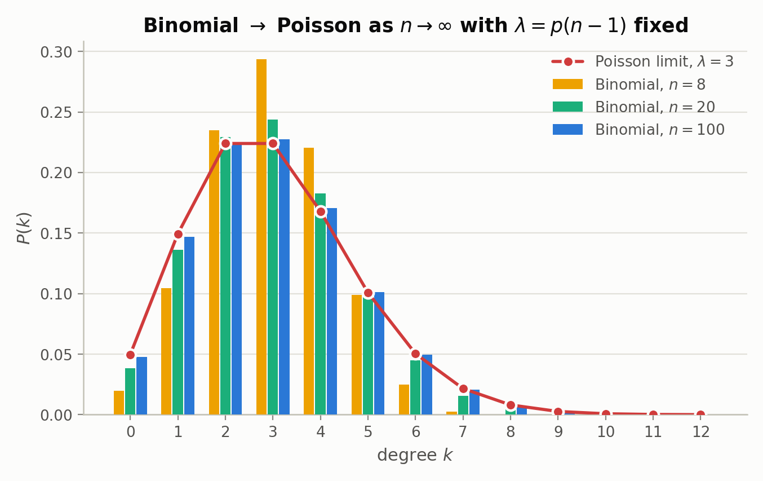
CONVERGENCE
How fast does the Binomial become Poisson?
Reading the figure
All four distributions have the same mean, λ = 3. Only n changes.
At n = 8 the Binomial is visibly compressed — the hard cut-off at k = n − 1 = 7 bites.
At n = 20 the shape is already close.
At n = 100 the largest pointwise discrepancy is 3.5 × 10⁻³ — indistinguishable at the resolution of any real measurement.
Convergence is O(1/n): the Poisson form is safe for any network of realistic size.
I · The Model and its Degree Distribution
7
Notes:
The pointwise error 3.5e-3 at n=100 was computed, not estimated.

Slide 8
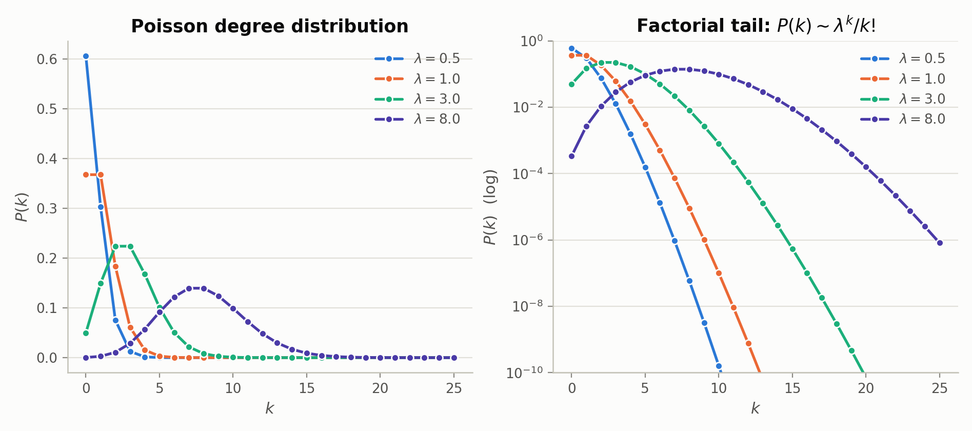
STRUCTURE
Anatomy of the Poisson degree distribution
Mean = variance
Single peak at k ≈ λ
Super-exponential tail
σ_k = √λ, so relative fluctuations √λ/λ = λ^(−1/2) shrink as the graph gets denser. Every node is statistically alike.
The mode is ⌊λ⌋. There is a characteristic degree — the very property that scale-free networks lack.
P(k) ~ λᵏ/k! decays faster than any exponential. Hubs are not merely rare; they are effectively forbidden.
I · The Model and its Degree Distribution
8
Notes:
Right panel is log-scale: the curvature downward is the factorial, and it is what kills hubs.

Slide 9
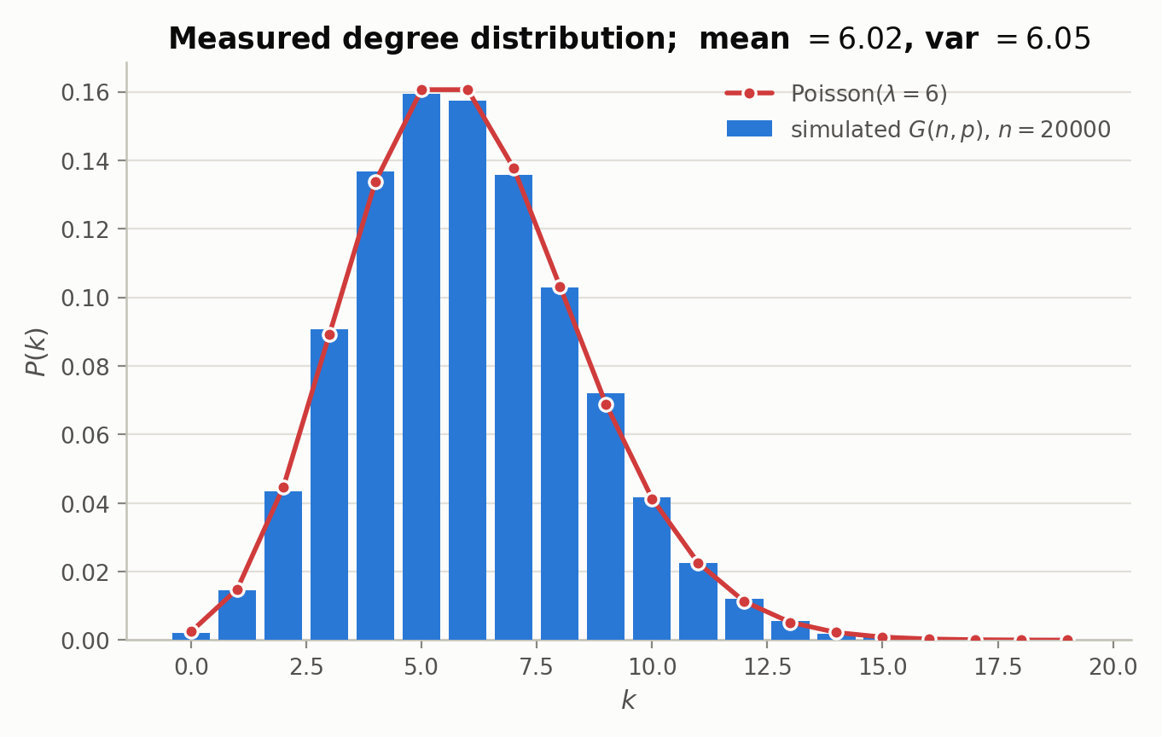
VERIFICATION
Simulation check: 20,000 nodes at ⟨k⟩ = 6
6.015
6.047
measured ⟨k⟩
measured Var(k)
Why this test matters
Mean = variance is the Poisson signature, and it holds to 0.5% on a single realisation.
This is a falsifiable prediction: measure ⟨k⟩ and Var(k) on any empirical network. If the ratio is far from 1, ER is the wrong null model.
For the Internet AS graph the ratio exceeds 100 — the first quantitative sign that a fat-tailed model is needed.
Var(k)/⟨k⟩ ≈ 1 is the cheapest one-number test of whether a network is Erdős–Rényi-like.
I · The Model and its Degree Distribution
9
Notes:
Simulation: networkx fast_gnp_random_graph, n=20000, p=6/(n-1), single realisation, seed 11.

Slide 10
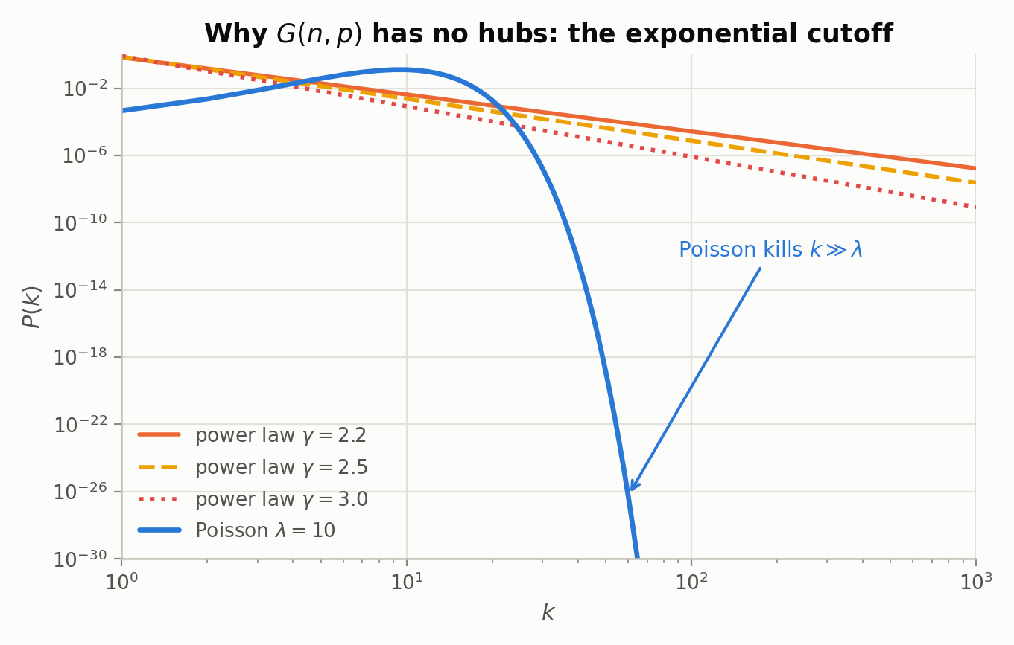
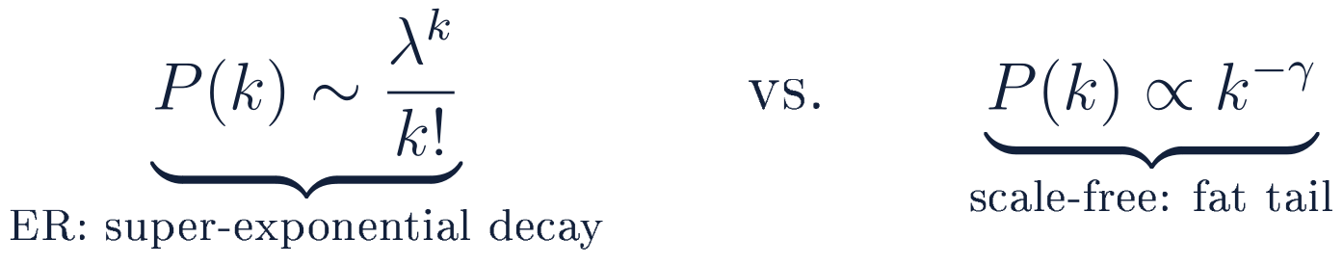
LIMITATION
Why G(n,p) cannot have hubs
REMARK — POISSON VS. REAL NETWORKS
The Internet router graph, protein-interaction networks and citation graphs all show P(k) ∝ k^(−γ) with 2 < γ < 3.
A Poisson law cannot reproduce this at any λ. The discrepancy is not a matter of fitting — it is structural.
The Configuration Model (Section VI) repairs exactly this defect.
The magnitude of the failure
k | Poisson(10) | k^(−2.5)
50 | 1.7 × 10⁻¹⁴ | 1.5 × 10⁻⁴
100 | 5.8 × 10⁻³⁵ | 2.6 × 10⁻⁵
1000 | ≈ 10⁻⁵⁷⁵ | 8.3 × 10⁻⁸
A degree-1000 hub is a 10⁻⁵⁷⁵ event under ER and a routine one under a power law.
I · The Model and its Degree Distribution
10
Notes:
Numbers in the table are exact Poisson pmf values, normalised power law over k=1..1000.

Slide 11

The Giant Component
and Percolation
II
The self-consistency equation · the graphical solution · critical exponent β = 1 · susceptibility divergence
III · The Giant Component and Percolation
19
Notes:
Section III: the celebrated transition, and the one with a genuine order parameter.

Slide 12
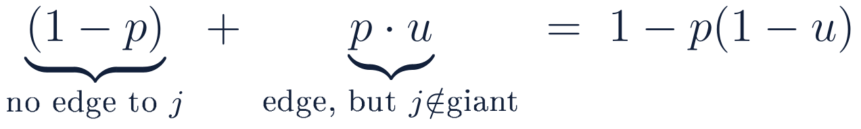
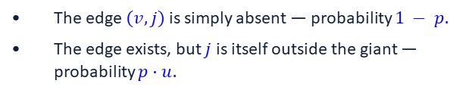
DERIVATION
Deriving the giant component — setup and Step 1
THE QUANTITY WE TRACK
The self-consistency idea
A node $v$ avoids the giant component if and only if every one of its neighbours also avoids it. That “if and only if” is what makes $u$ appear on both sides of an equation — and a self-referential equation in a single unknown is something we can solve.
1
Contribution of one potential neighbour j
Two disjoint ways for j to fail to connect v
The edge $(v, j)$is simply absent — probability $1 − p.$
The edge exists, but $j$ is itself outside the giant — probability $p·u.$
The tree assumption is hiding here: we treat j's fate as independent of v's. In a sparse graph, short cycles through v and j are rare — probability O(⟨k⟩²/n) — so the local neighbourhood is a tree with probability → 1. This is the one approximation in the derivation, and it is asymptotically exact.
III · The Giant Component and Percolation
20
Notes:
Flag the locally-tree-like assumption explicitly. It is the same assumption that later makes clustering vanish.

Slide 13
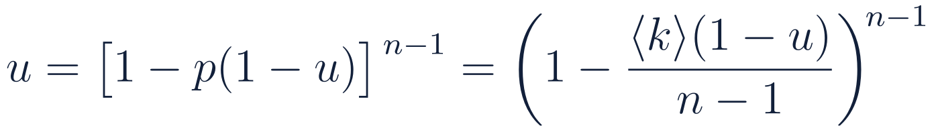
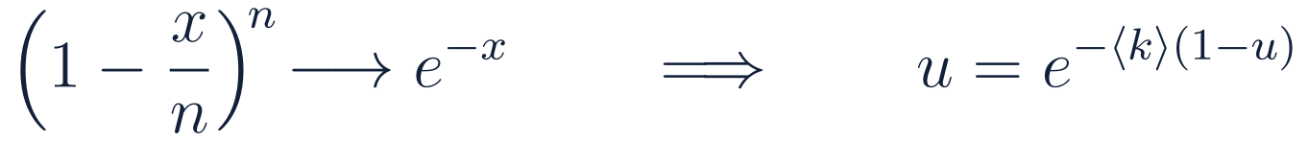
DERIVATION
Steps 2 and 3 — all neighbours, then the limit
2
All n − 1 potential neighbours must fail, independently
Substituting p = ⟨k⟩/(n−1) puts the expression in the canonical form (1 − x/m)^m.
3
Thermodynamic limit n → ∞
Note what survived the limit
n and p vanished
u is now implicit
Exactness
Only the product ⟨k⟩ = pn appears. The mean degree is the sole control parameter — a graph of 10³ and one of 10⁹ nodes behave identically at the same ⟨k⟩.
u = e^(−⟨k⟩(1−u)) is transcendental: no closed form in elementary functions. We solve it graphically and numerically.
The only approximations used were (1 − x/m)^m → e^(−x) and local tree-likeness. Both are exact as n → ∞ at fixed ⟨k⟩.
III · The Giant Component and Percolation
21
Notes:
The disappearance of n is the deep point: universality. Only <k> matters.

Slide 14
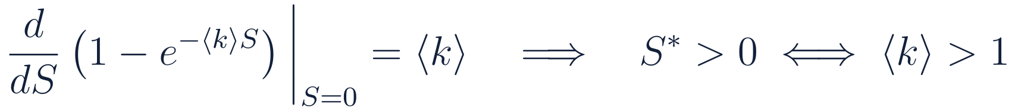
RESULT
Step 4 — the order parameter equation
4
Define the giant-component fraction S = 1 − u
SELF-CONSISTENCY EQUATION FOR THE ORDER PARAMETER
Solving it
Numerical solutions
⟨k⟩ | S | interpretation
0.5 | 0 | subcritical — no giant
1.0 | 0 | critical — still zero, but marginally
1.5 | 0.5828 | 58% of nodes in one component
2.0 | 0.7968 | 80%
3.0 | 0.9405 | 94%
5.0 | 0.9930 | 99.3% — but not yet connected
S = 0 is always a solution. The question is whether a second, positive solution exists.
The curve 1 − e^(−⟨k⟩S) starts at the origin with slope ⟨k⟩ and is concave. It crosses the line y = S a second time precisely when its initial slope exceeds 1.
Hence ⟨k⟩ = 1 is the critical point — and the branching interpretation is immediate: ⟨k⟩ is the expected number of offspring per node.
Solutions computed by Brent root-finding on S − 1 + e^(−⟨k⟩S) = 0.
III · The Giant Component and Percolation
22
Notes:
At <k>=5 the giant holds 99.3% of nodes and the graph is still disconnected — the ln n threshold is far above 5 for any large n. This is the punchline of the two-threshold story.

Slide 15
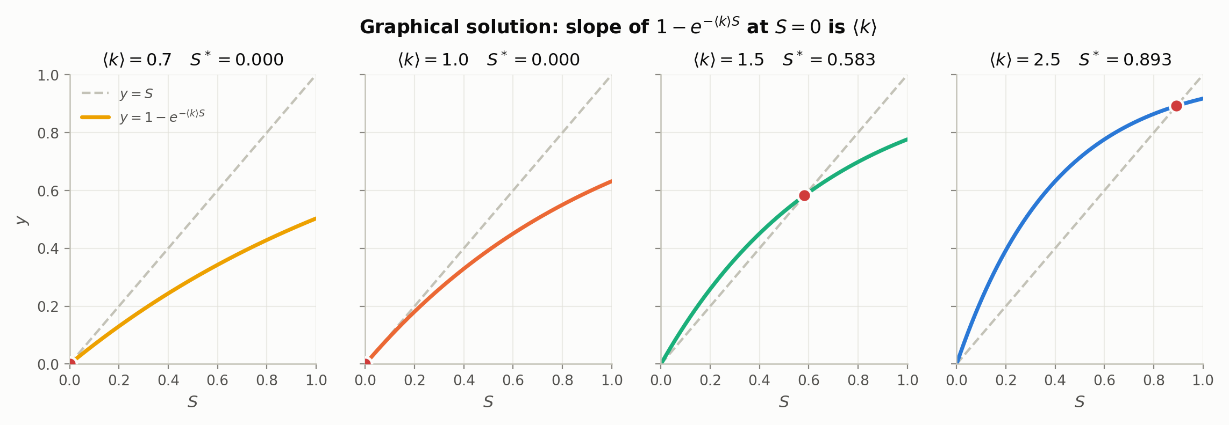
GEOMETRY
The graphical solution: a tangency at ⟨k⟩ = 1
⟨k⟩ = 0.7
⟨k⟩ = 1.0
⟨k⟩ = 1.5
⟨k⟩ = 2.5
Slope at the origin < 1. The concave curve stays below the diagonal — S = 0 is the only fixed point.
Tangency. The curve touches the diagonal at the origin and nowhere else. This is the critical point.
Slope > 1. The curve rises above the diagonal, must come back down, and a positive fixed point appears.
The fixed point has moved to S* = 0.797. As ⟨k⟩ grows it approaches 1 but never reaches it.
III · The Giant Component and Percolation
23
Notes:
The tangency picture is the whole transition: a fixed point being born as a slope crosses one. Identical mathematics to the mean-field Ising magnetisation.

Slide 17
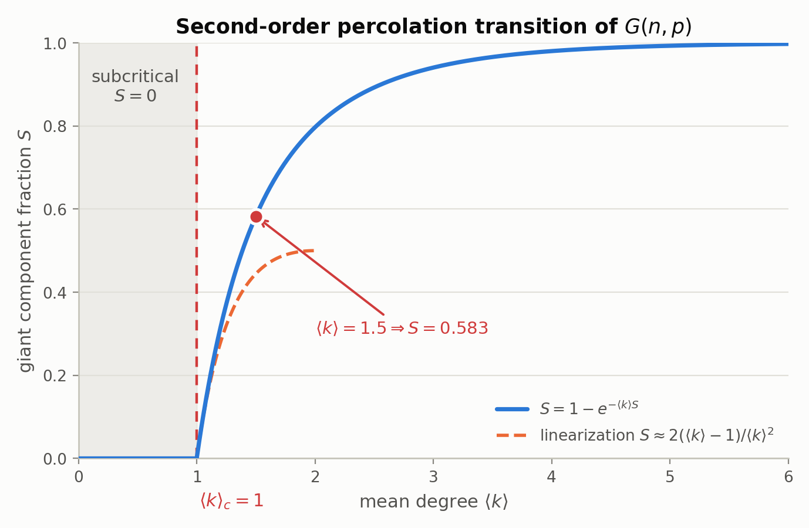
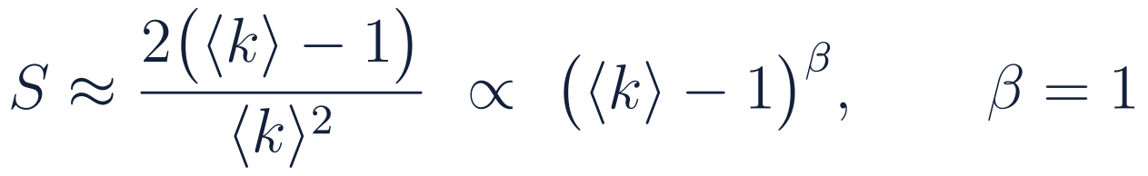
CRITICAL BEHAVIOUR
A second-order transition with exponent β = 1
NEAR-CRITICAL EXPANSION
Why “second order”
S is continuous at ⟨k⟩ = 1 — it rises from zero rather than jumping. A first-order transition would show a discontinuity.
Its derivative dS/d⟨k⟩ is discontinuous: 0 below, 2 just above. The singularity sits in the first derivative of the order parameter.
Expanding S = 1 − e^(−⟨k⟩S) to second order in small S gives S ≈ 2(⟨k⟩−1)/⟨k⟩², so S ∝ (⟨k⟩ − 1)¹ and the critical exponent is β = 1.
β = 1 is the mean-field percolation value — expected, since ER has no geometry and every node interacts with every other with equal probability.
The dashed orange curve is the linearised prediction; it tracks the exact solution to within a few percent up to ⟨k⟩ ≈ 1.4.
III · The Giant Component and Percolation
24
Notes:
Derivation of beta: 1-e^{-kS} ≈ kS - (kS)^2/2, set equal to S, solve for S.

Slide 18
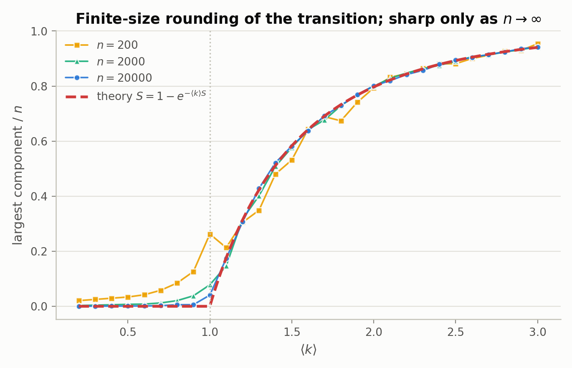
FINITE-SIZE EFFECTS
At finite n the transition is rounded
What simulation shows
At n = 200 the “transition” is a broad shoulder; the largest component is a sizeable fraction of the graph even at ⟨k⟩ = 0.6.
At n = 20,000 the measured curve hugs the theory except in a narrow window around ⟨k⟩ = 1.
The rounding width scales as n^(−1/3), and at criticality the largest component is Θ(n^(2/3)) — a vanishing fraction, but far from small.
PRACTICAL CONSEQUENCE
Sharp thresholds are statements about the n → ∞ limit only. Any measurement on a real, finite network sees a smooth crossover, so “is this network above the percolation threshold?” is never answered by a single number — it needs the finite-size scaling form.
III · The Giant Component and Percolation
25
Notes:
Simulation: 8 realisations per point for n=200 and 2000, 3 for n=20000.

Slide 19
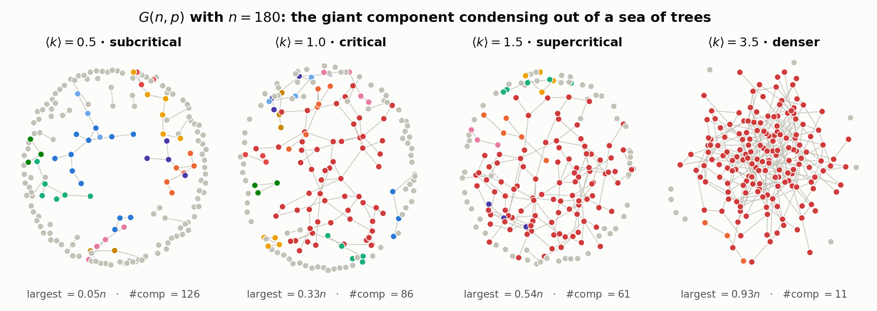
VISUALISATION
Watching the giant component condense
Sea of small trees
Critical
Giant emerges
Nearly connected
126 components, largest holds 5% of nodes. Every component is a tree — no cycles have appeared yet.
One component is now visibly larger than the rest, but at n = 180 finite-size fluctuations are severe: theory says Θ(n^(2/3)) ≈ 32 nodes.
A single component spanning 54% of the graph, coexisting with 60 small ones and many isolated vertices.
93% in the giant. The stragglers are isolated vertices — exactly the obstruction Section II analysed.
III · The Giant Component and Percolation
26
Notes:
Crimson = largest component. Grey = isolated vertices and pairs. Same n and layout algorithm across all four; only p changes.

Slide 21
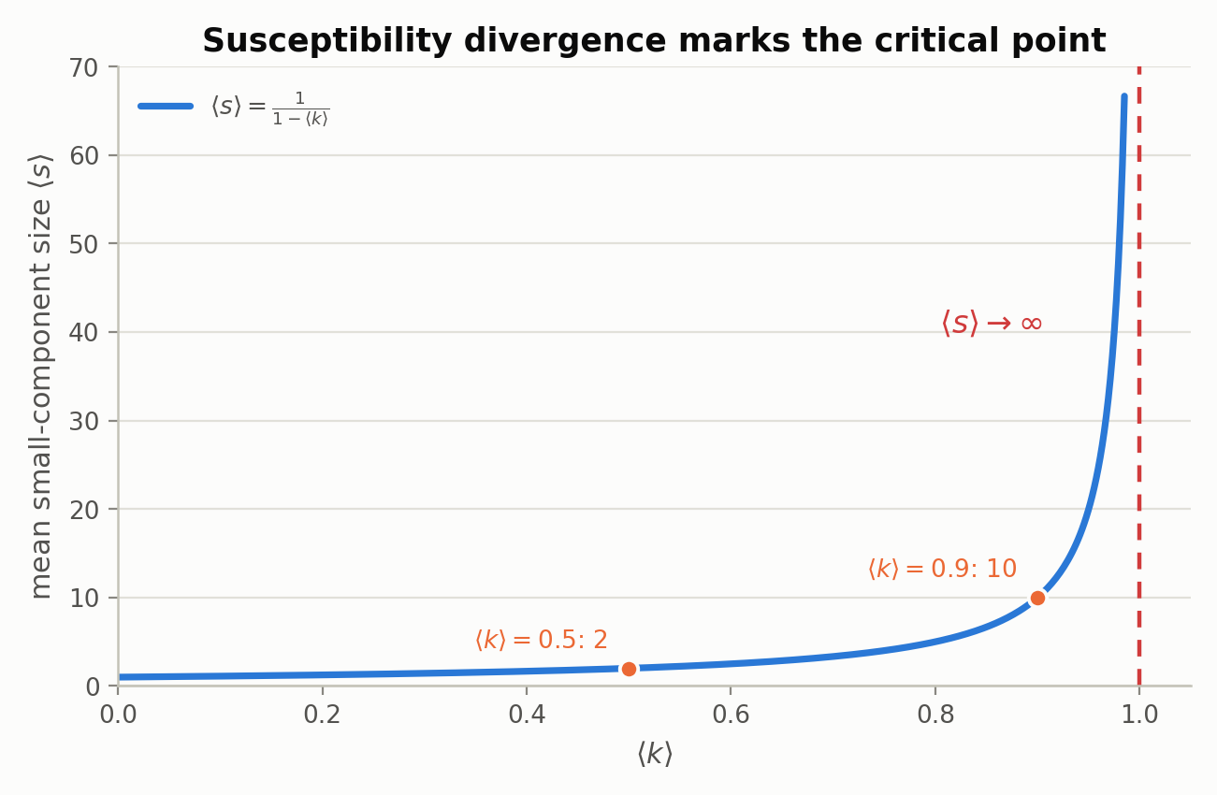
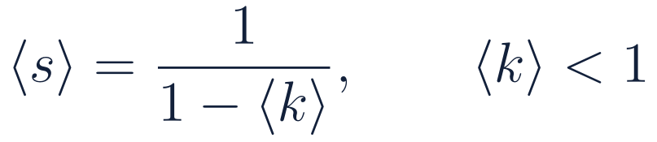
BRANCHING PROCESS
Susceptibility: the divergence that locates the critical point
The branching-process argument
Exploring a component from a random root is a Galton–Watson process with Poisson(⟨k⟩) offspring.
Expected total progeny of a subcritical branching process with mean offspring m < 1 is the geometric sum 1 + m + m² + ⋯ = 1/(1 − m).
With m = ⟨k⟩ this is exactly ⟨s⟩ = 1/(1 − ⟨k⟩). Section VII rederives it from the generating function, with no geometric-series hand-waving.
WHY DIVERGENCE MARKS THE TRANSITION
⟨s⟩ is the percolation analogue of magnetic susceptibility. It diverges as ⟨k⟩ → 1⁻ because the typical component is being driven to macroscopic size — the giant component is being born. This gives an independent, order-parameter-free way to locate ⟨k⟩ = 1: look for where a mean, not a fraction, blows up.
Above the threshold the picture is extremely bimodal: one component of size Θ(n), all others O(log n). Nothing in between.
III · The Giant Component and Percolation
27
Notes:
Note the geometric series here is heuristic; slide 47 gives the rigorous PGF derivation. Deliberate forward reference.

Slide 22
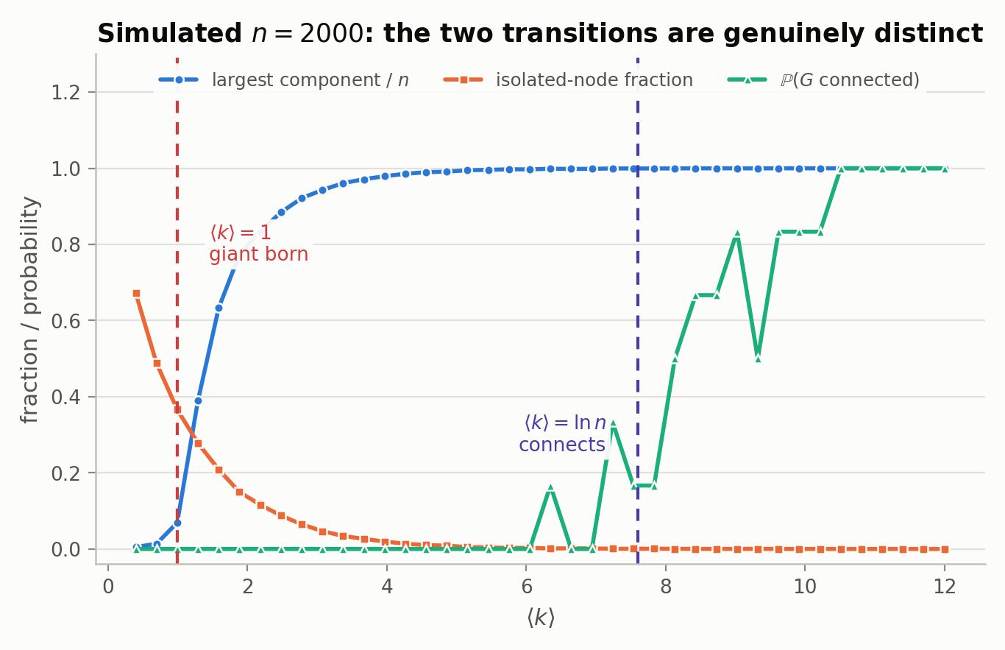
VERIFICATION
Both transitions in one simulation, n = 2000
Three observables, two transitions
The largest-component curve lifts off near ⟨k⟩ = 1 and saturates well before connectivity is reached.
The isolated-node fraction decays as e^(−⟨k⟩) and is still non-zero at ⟨k⟩ = 5, where the giant already holds 99% of nodes.
ℙ(connected) stays pinned at zero until ⟨k⟩ approaches ln 2000 ≈ 7.6, then rises steeply — the second transition.
1
7.6
⟨k⟩ for giant
⟨k⟩ for connected
A factor of 7.6 apart at n = 2000 — and the gap grows like ln n.
III · The Giant Component and Percolation
28
Notes:
6 realisations per point. This single figure closes Sections II and III together.

Slide 23
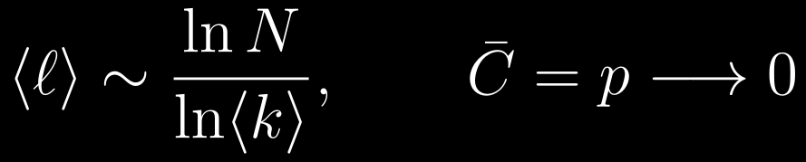
Distances, Correlations
and Clustering
III
Breadth-first shells and the small-world property · the friendship paradox from size-biased sampling · why clustering vanishes
IV · Distances, Correlations, Clustering
29
Notes:
Section IV: two successes (short paths, the paradox) and one instructive failure (clustering).

Slide 24
Average pathlength
ALBERT-LÁSZLÓ BARABÁSI

Slide 25
Average pathlength
(1)
Eqn. 1
ALBERT-LÁSZLÓ BARABÁSI

Slide 26
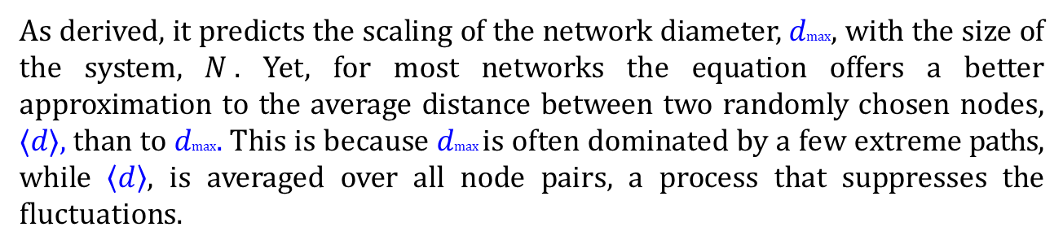
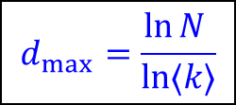
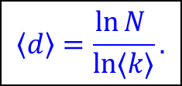
Average pathlength
Eqn. 1
Therefore, the diameter of a random network follows
$$d_{max}⁡=\frac{\ln{N }}{\ln{⟨k⟩}}$$
Actually, we can write,
$$\left\langle d\right\rangle =\frac{\ln{N }}{\ln{⟨k⟩}}.$$
As derived, it predicts the scaling of the network diameter, $dmax$, with the size of the system, $N$. Yet, for most networks the equation offers a better approximation to the average distance between two randomly chosen nodes, $⟨d⟩,$than to $dmax.$This is because $dmax$ is often dominated by a few extreme paths, while $\left\langle d\right\rangle ,$ is averaged over all node pairs, a process that suppresses the fluctuations.
ALBERT-LÁSZLÓ BARABÁSI

Slide 27
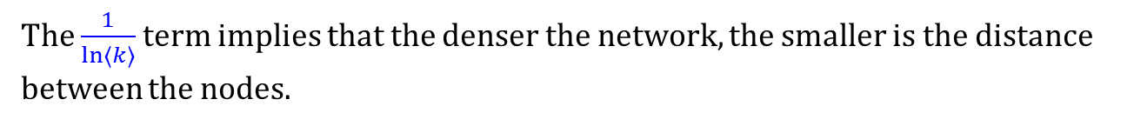
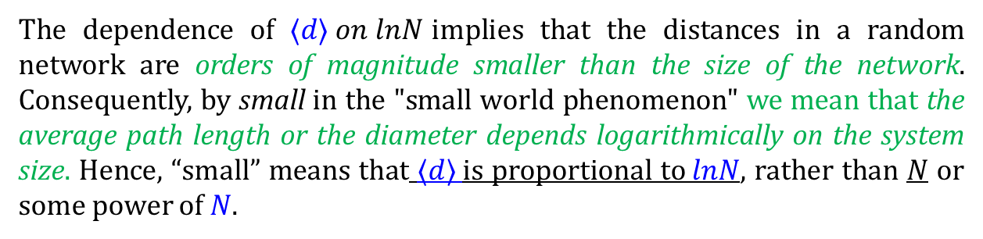
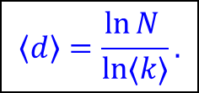
Average pathlength
The dependence of $⟨d⟩ on lnN$implies that the distances in a random network are orders of magnitude smaller than the size of the network. Consequently, by small in the "small world phenomenon" we mean that the average path length or the diameter depends logarithmically on the system size. Hence, “small” means that $⟨d⟩$is proportional to$lnN$, rather than $N$ or some power of $N$.
The $\frac{1}{\ln{⟨k⟩}}$term implies that the denser the network, the smaller is the distance between the nodes.
$$\left\langle d\right\rangle =\frac{\ln{N }}{\ln{⟨k⟩}}.$$
ALBERT-LÁSZLÓ BARABÁSI

Slide 28

Average pathlength
$$\left\langle d\right\rangle =\frac{\ln{N }}{\ln{⟨k⟩}}.$$
ALBERT-LÁSZLÓ BARABÁSI

Slide 29
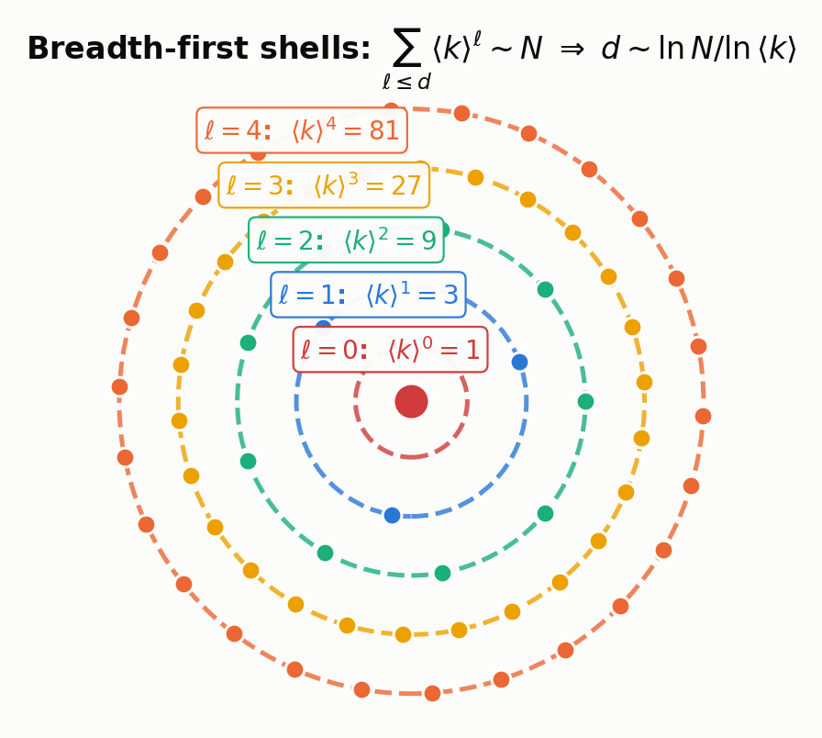
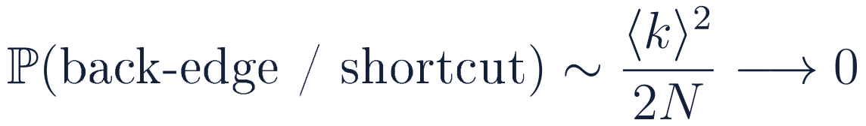
DERIVATION
Breadth-first shells: counting outward from a root
SHELL SIZES BY INDUCTION
Level 0 is the source itself. Level 1 contains its ⟨k⟩ immediate neighbours in expectation.
Each level-1 node has ⟨k⟩ further neighbours. If none of them were already seen, level 2 has ⟨k⟩² nodes.
The correction is the probability that an edge points back into an already-visited node — a shortcut. In a sparse graph:
The same tree assumption, used a second time
Ignoring back-edges is legitimate for the same reason the giant-component derivation could treat neighbours as independent: locally, a sparse random graph looks like a tree. The shells therefore grow geometrically, and a geometric growth process reaches n nodes in logarithmically many steps. That single observation is the entire small-world result.
IV · Distances, Correlations, Clustering
30
Notes:
Geometric growth is the mechanism; the logarithm is just its inverse.

Slide 30
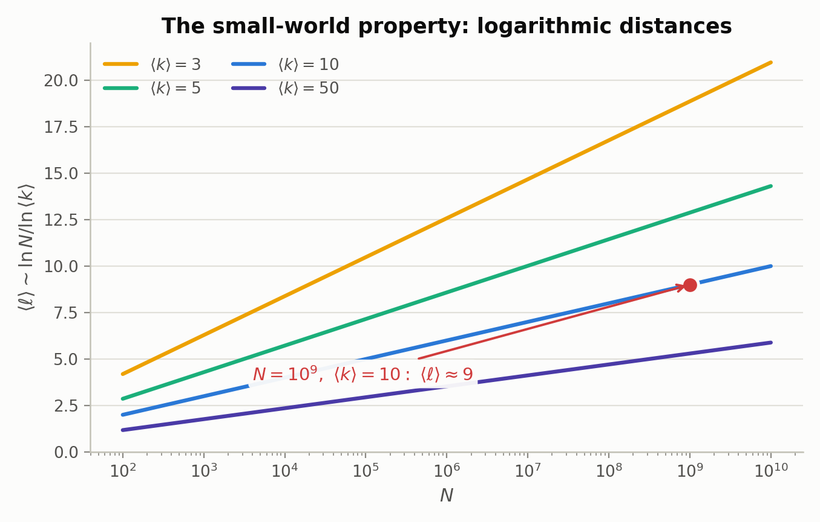
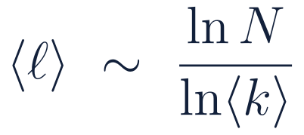
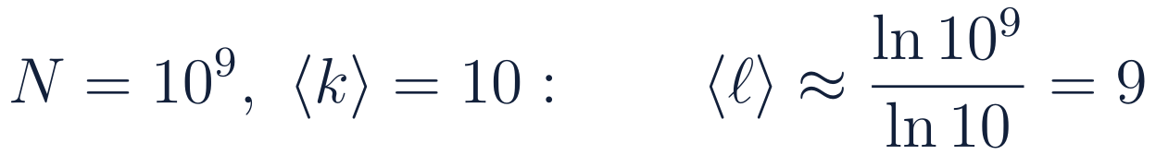
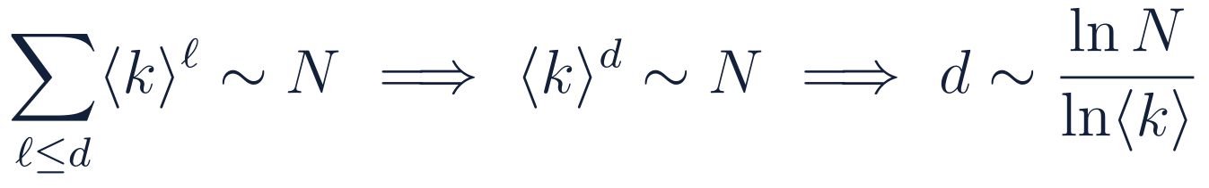
RESULT
The small-world property, quantified
AVERAGE PATH LENGTH
WORKED EXAMPLE
Why ⟨ℓ⟩ and the diameter coincide
The diameter is the largest shortest path; the average path length is the mean over all pairs. In general these differ substantially.
In G(n,p) they share the same leading behaviour because the variance of ℓ over pairs is O((ln N / ln⟨k⟩)² / N) → 0.
Almost every pair of nodes sits at almost exactly the same distance. The distance distribution concentrates onto a single value — there is no “periphery”.
A billion-node network with ⟨k⟩ = 10 has essentially every pair nine hops apart.
IV · Distances, Correlations, Clustering
31
Notes:
The concentration of the distance distribution is what makes ER a poor model of geography and a good model of, say, well-mixed epidemics.

Slide 31
Clustering: two derivations, one answer

Slide 32
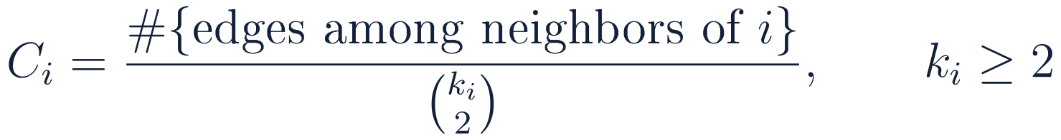
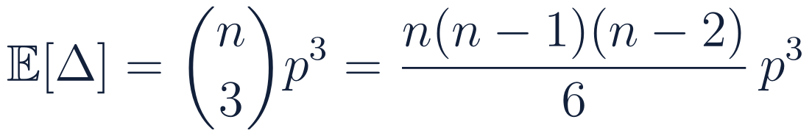
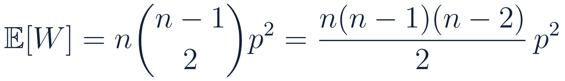
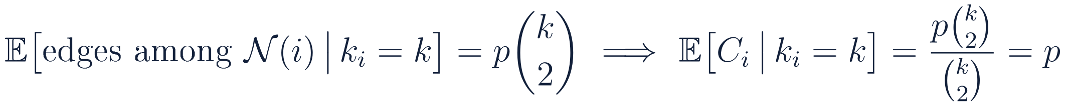
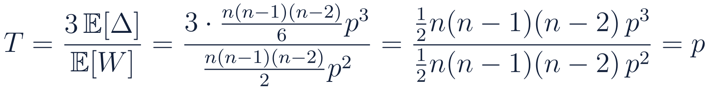
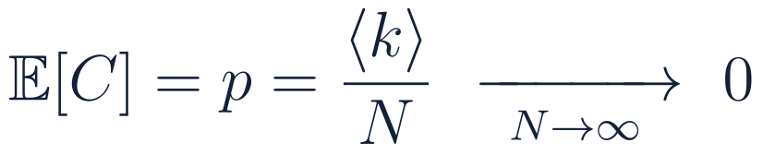

DERIVATION
Clustering: two derivations, one answer
Local clustering coefficient
Global transitivity
T is defined as three times the number of triangles divided by the number of connected triples (wedges). Count both expectations directly:
Fix node i with k_i = k ≥ 2 neighbours. There are C(k,2) potential edges among them.
Each is present independently with probability p — edges in G(n,p) do not know about each other.
The result is independent of k: every node has the same expected clustering, whatever its degree. Empirical networks almost always show C(k) decreasing in k.
Every combinatorial factor cancels exactly. T = p is not an approximation — it is an identity, and it agrees with the local calculation.
IV · Distances, Correlations, Clustering
34
Notes:
Two independent routes — a local conditional expectation and a global ratio of counts — give the same answer. In ER, C-bar = T = p exactly.

Slide 33
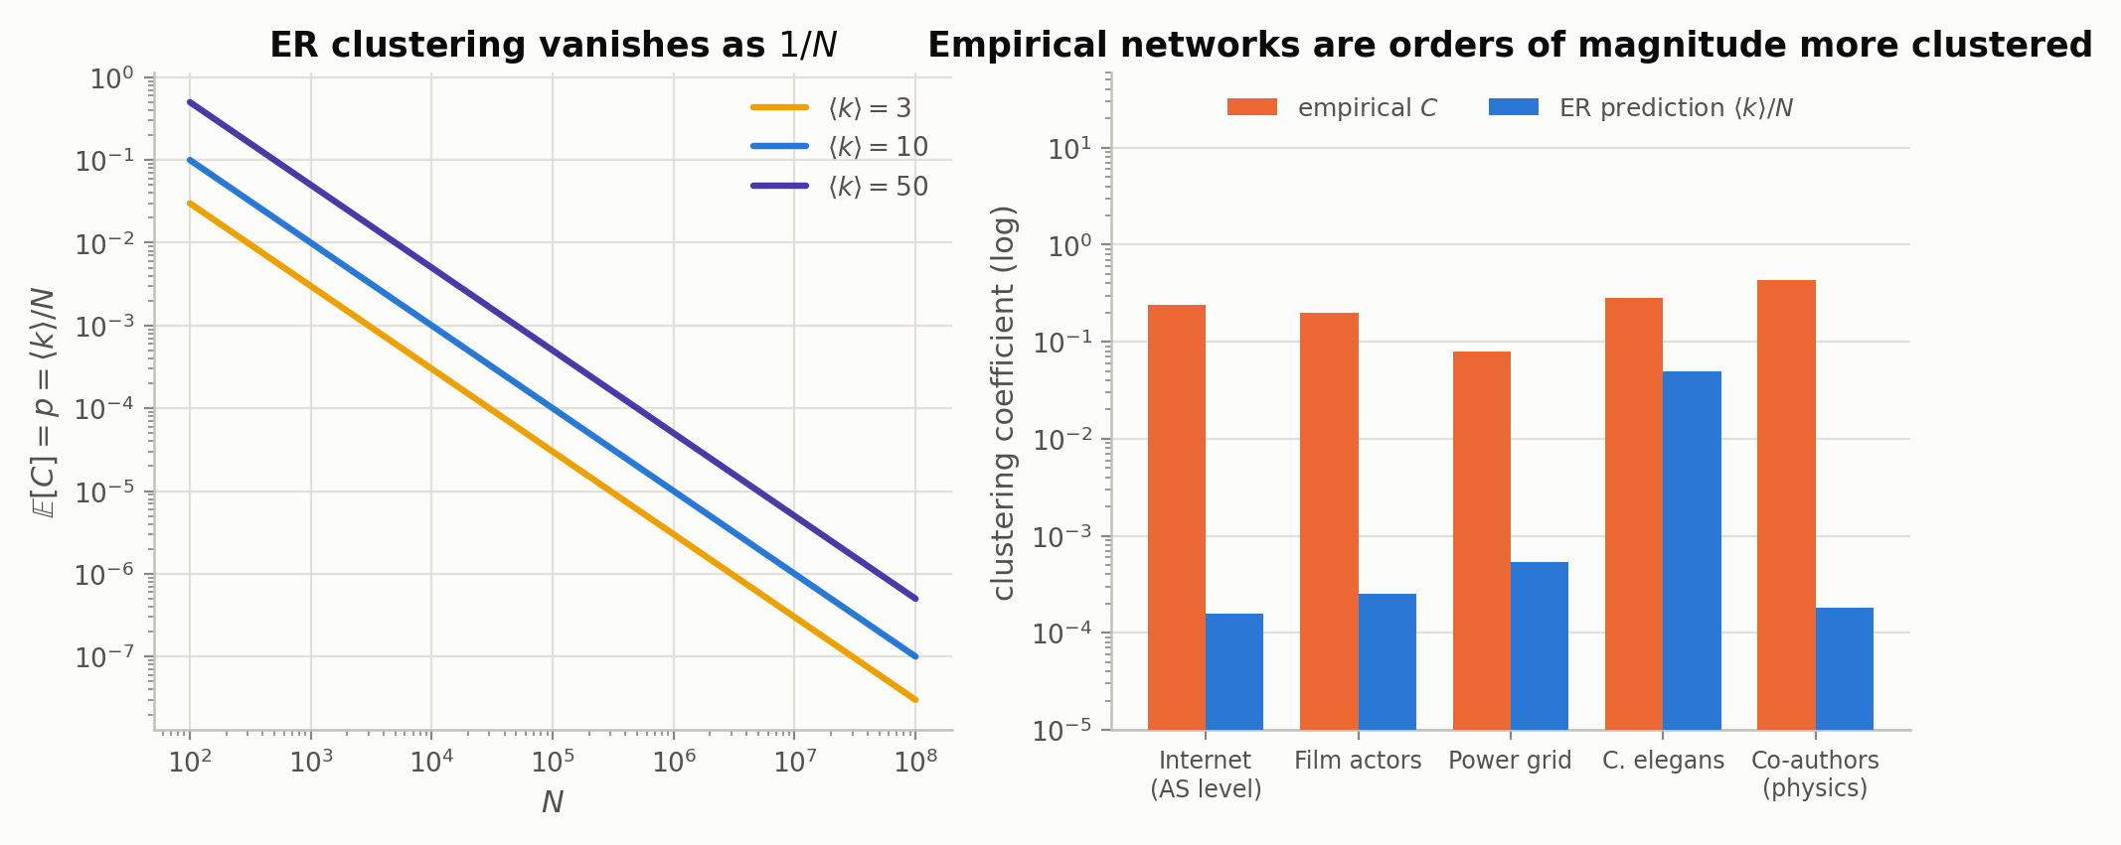
LIMITATION
The one place G(n,p) fails badly
REMARK — THE SMALL-WORLD PARADOX
Watts–Strogatz resolves it
Real social networks show L = O(log N) — short paths, just like G(n,p) — and simultaneously C̄ = Θ(1), high clustering, quite unlike G(n,p). No single-parameter random graph can do both.
Start from a ring lattice, which has C̄ = Θ(1) but L = Θ(N), and rewire a small fraction of edges at random. The shortcuts collapse the path length logarithmically while leaving the dense local triangles intact — high C̄ and short L together.
IV · Distances, Correlations, Clustering
35
Notes:
Right panel: ER predictions computed as <k>/N from each network's published n and mean degree. The gap is three to four orders of magnitude.

Slide 35




DERIVATION
The friendship paradox from size-biased sampling
DEFINITION 6.1 — AVERAGE NEAREST-NEIGHBOUR DEGREE
1
Sampling a node by following an edge is not uniform
A node of degree k is incident to k edges, so it is k times more likely to be reached by following a random edge than a degree-1 node. The correctly normalised edge-biased distribution is q_k ∝ k·P(k).
2
Expected degree of a neighbour
3
Rewrite the second moment
Because Var(k) > 0 for any graph whose nodes do not all have identical degree, ⟨k_nn⟩ > ⟨k⟩ holds universally — for every network, real or synthetic. The paradox is a property of how we sample, not of how people make friends.
4
Specialise to Poisson: Var(k) = ⟨k⟩
IV · Distances, Correlations, Clustering
32
Notes:
The universality of <k_nn> > <k> is the memorable part. The ER specialisation to exactly +1 is the cute part.

Slide 36



The nearest-neighbour degree ⟨k_nn⟩
notes, page 8
the mean degree of the neighbours of one node i
averaged over all N nodes of the graph
notes, p.8 — eqs. (9) and (10)
THE CLAIM THE NOTES MAKE
⟨k_nn⟩ is NOT equal to ⟨k⟩. The degrees of the nodes you arrive at by following edges are drawn from a different distribution than the degrees of nodes you pick at random. That distribution has a name: q_k.
Notes:
Definitions first, then the surprise. Note that eq (10) averages over NODES with equal weight - that is the definition in the notes. There is a second, edge-weighted average which is the one that equals <k^2>/<k> exactly in any graph; for Poisson degrees the two coincide, which is why the notes' claim is correct here. We verify both numerically in a moment.

Slide 37


The distribution at the end of an edge
notes, pages 9–10
1
Count edge-ends, not nodes. The graph has 2m = N⟨k⟩ edge-ends in total.
2
A node of degree k owns exactly k of them — so it is k times as easy to reach as a node of degree 1.
SIZE-BIASED SAMPLING
AND IT IS EXACT
q_k is p_k tilted by k and renormalised. Low degrees are under-represented, high degrees over-represented — the same effect that makes a bus look fuller than average to the average passenger.
This holds in ANY graph, random or not. It is a statement about how edges sample vertices, with no model assumption at all.
Notes:
The edge-end counting argument is the cleanest derivation and it is what the notes do on page 9 with the 10-node graph: 20 edge-ends, 5 of them belong to the degree-5 node, so q_5 = 5/20. Say the bus/queue analogy out loud - it lands.

Slide 38

The notes' worked example, reproduced
notes, page 9 · N = 10
q₁ = 1/5 < p₁ = 2/5
q₂ = 2/5 = p₂ = 2/5
q₅ = 5/20 > p₅ = 1/10
degree-1 nodes are hard to reach
degree ⟨k⟩ = 2 is unbiased
the hub is 2.5× easier to reach
Every number here matches the notes exactly: q₁ = 1/5, q₂ = 2/5, q₃ = 3/20, q₅ = 5/20, and Σ k q_k = ⟨k²⟩/⟨k⟩ = 2.7.
Notes:
This is the notes' own example rebuilt: degrees 1,1,1,1,2,2,2,2,3,5, sum 20, <k> = 2. Walk through q_5 = 5 x (1/10) / 2 = 5/20 = 0.25 versus p_5 = 0.10. The crossover is exactly at k = <k>: below it q < p, above it q > p, and equality at k = <k> = 2. That is a general feature of size-biasing.

Slide 39


Σ k q_k = ⟨k²⟩/⟨k⟩
notes, page 10
1
Substitute q_k = k p_k / ⟨k⟩ and collect:
THAT IS THE WHOLE PROOF
One substitution. The second moment appears because size-biasing multiplies by k once, and taking the mean multiplies by k again.
WHY ⟨k_nn⟩ EQUALS THIS SUM
A GENERAL INEQUALITY
In an uncorrelated graph the degree of the node at the far end of an edge is independent of where you started. So averaging over nodes and averaging over edges give the same answer, and ⟨k_nn⟩ is just the mean of q.
⟨k²⟩/⟨k⟩ = ⟨k⟩ + Var(k)/⟨k⟩ ≥ ⟨k⟩, with equality only if every degree is identical. Any spread in the degrees makes your neighbours better connected than you.
Notes:
The identity <k^2>/<k> = <k> + Var(k)/<k> is the one to remember - it makes the friendship paradox obvious and quantitative. It also shows the effect is about variance, so it is strongest for heavy-tailed degree distributions, which is why it matters so much for scale-free networks.

Slide 40



For ER: ⟨k_nn⟩ = ⟨k⟩ + 1
notes, page 11
A SECOND, DIRECT PROOF
Given that j is a neighbour of i, j's other N−2 pairs are still independent coin flips. So k_j = 1 + Bin(N−2, p), whose mean is 1 + ⟨k⟩ — for every i, whatever i's own degree.
THE FRIENDSHIP PARADOX
Your friends have, on average, exactly one more friend than you do. Measured points sit on ⟨k⟩+1 across the whole range.
Notes:
Two proofs are worth giving because they illuminate different things. The moment proof shows it is Var(k)/<k> = 1 for Poisson. The direct proof shows WHERE the +1 comes from: the edge you arrived along. Measured: at <k>=2 we got 3.047 vs 3; at <k>=10, 10.95 vs 11.

Slide 41



So ρ = ⟨k⟩, and the shells grow geometrically
notes, page 12
AND THE SAME ARGUMENT REPEATS
Nothing about the step from z₁ to z₂ used the number 2. Each new shell multiplies by ρ = ⟨k⟩ again.
THE PICTURE
Breadth-first search from any node fans out by a factor ⟨k⟩ per step. This is exactly the BFS shell census in the dashboard — the mechanism behind every “small world” claim.
notes, p.12 — eq. (16)
Notes:
The repetition argument is worth stating explicitly: the calculation for z_2 never used the fact that we were on step 2, so it iterates. This is exactly the shell census panel in the ER dashboard - open it here and drag <k> to watch the bars follow <k>^l.

Slide 42



Sum the shells, invert, and L appears
notes, pages 13–14
1
Total nodes within distance m — a geometric series:
2
For ⟨k⟩ ≫ 1 the correction 1/⟨k⟩ is small, so S ≈ ⟨k⟩^m: the last shell dominates the whole ball.
3
Most nodes sit at distance ≈ L, so the ball of radius L must hold essentially the whole graph:
Notes:
Step 3 is the one that deserves a caveat: 'most nodes at distance about L' is exactly the statement the notes make on page 13, and it is right because the shell sizes are geometric - the last shell dominates. So the ball of radius L holding N nodes gives <k>^L = N immediately.

Slide 43

L measured, both ways
growth in N and decay in ⟨k⟩
THE TWO SIGNATURES
AND A HONEST 5%
Left: at fixed ⟨k⟩ = 6, L rises like ln N. Right: at fixed N = 2 000, L falls like 1/ln⟨k⟩.
Measured L runs about 5% above ln N/ln⟨k⟩. The leading behaviour is right; the sub-leading constant is not claimed.
Notes:
Be straight about the 5%: the formula captures the scaling, not the constant. Refinements like L = ln(N/<k>)/ln<k> + 1/2 exist. What matters for the physics is the ln N - a graph of a billion nodes has L around 9 or 10 at <k> = 10.

Slide 44



The notes' own exercise
notes, p.12 · ⟨k⟩ = 10
THE ANSWER, IN ONE LINE
Geometric growth cannot outlast the graph. z_m = ⟨k⟩^m must be ≤ N, so the shells can keep doubling only until m reaches ln N / ln⟨k⟩ — which is precisely L.
notes, p.12
Measured shells at ⟨k⟩ = 10. Bars follow ⟨k⟩^m (red) until the dashed line N is reached at m = ln N/ln⟨k⟩ (purple), then collapse — there is nothing left to discover.
Notes:
This directly answers the question written in the notes. For N = 10^3 and <k> = 10 the prediction z_4 = 10^4 exceeds the entire graph, so it is impossible; measurement gives 522 and then 9. The saturation point is m = L, which closes the loop with the previous slide beautifully.

Slide 45

CONSEQUENCE
Exactly one extra friend — and why heavy tails break it
The ER answer
The scale-free answer
Remark — assortativity
Var(k)/⟨k⟩ = 1 for Poisson, so the excess is exactly one friend — independent of ⟨k⟩. A gap that neither grows nor shrinks with density.
For γ < 3 the second moment diverges with system size, so ⟨k_nn⟩/⟨k⟩ grows without bound. Your friends are not slightly more popular — they are enormously more popular.
The Pearson degree correlation r is exactly 0 in G(n,p) — edges are placed without regard to degree. Social networks are assortative (r > 0); technological and biological ones disassortative (r < 0).
IV · Distances, Correlations, Clustering
33
Notes:
Right panel uses a continuous power law with k_max = 10^4 — the divergence is cut off by finite size, which is exactly what happens in real data.

Slide 47

Thresholds and
Connectivity
IV
Threshold functions and sharp transitions · isolated nodes · the Chen–Stein Poisson approximation · the double-exponential window
II · Thresholds and Connectivity
11
Notes:
Section II: the first phase transition. Note it is NOT the giant-component transition.

Slide 48

Properties of Random Network (ER): Isolated nodes
Each of the $n−1$possible edges between $v$ and the other nodes is present independently with probability $p$.
So the probability that $v$ has degree 0 (i.e. is isolated) is
$$Pr⁡(v is isolated)={\left(1−p\right)}^{n−1}.$$
This is simply the probability every one of those $n−1$edges is absent.

Slide 49

Properties of Random Network (ER): Isolated nodes
$$Pr⁡(v is isolated)={\left(1−p\right)}^{n−1}.$$
The degree of $v$ is $Binomial(n−1,p).$
The isolated-event is the $k=0$case of that distribution.
Let $X$ be the number of isolated nodes in the graph. Then
$X∼Binomial\left(n−1,q\right),$ where ${q=\left(1−p\right)}^{n−1}$

Slide 50

Properties of Random Network (ER): Isolated nodes
$$Pr⁡(v is isolated)={\left(1−p\right)}^{n−1}.$$
The degree of $v$ is $Binomial(n−1,p).$
The isolated-event is the $k=0$case of that distribution.
Let $X$ be the number of isolated nodes in the graph. Then
$X∼Binomial\left(n−1,q\right),$ where ${q=\left(1−p\right)}^{n−1}$
Thus, $E\left(X\right)=\left(n−1\right)q$ and $Var\left(X\right)=nq(1−q)$

Slide 51


Properties of Random Network (ER): Isolated nodes
$$Pr⁡(v is isolated)={\left(1−p\right)}^{n−1}.$$
The degree of $v$ is $Binomial(n−1,p).$
And $X∼Binomial\left(n−1,q\right),$ where ${q=\left(1−p\right)}^{n−1}$
Thus, $E\left(X\right)=\left(n−1\right)q$ and $Var\left(X\right)=nq(1−q)$
Poisson / asymptotic approximations. If $p=\frac{c}{n}(constant c>0)$, then
${\left(1−p\right)}^{n−1}∼e^{−c}$.

Slide 52



Properties of Random Network (ER): Isolated nodes
$$Pr⁡(v is isolated)={\left(1−p\right)}^{n−1}.$$
The degree of $v$ is $Binomial(n−1,p).$
And $X∼Binomial\left(n−1,q\right),$ where ${q=\left(1−p\right)}^{n−1}$
Thus, $E\left(X\right)=\left(n−1\right)q$ and $Var\left(X\right)=nq(1−q)$
Poisson / asymptotic approximations. If $p=\frac{c}{n}(constant c>0)$, then
${\left(1−p\right)}^{n−1}∼e^{−c}$.
Then, $E\left(X\right)=n{\left(1−p\right)}^{n−1}≈n e^{−c}=n e^{−np}$
If $c=\ln{n};$then $E\left(x\right)=n e^{−\ln{n }}=\frac{n}{n}=1$ (Fewer isolated nodes)
If $c=2\ln{n};$then $E\left(x\right)=n e^{−\ln{n^{2} }}=\frac{n}{n^{2}}=\frac{1 }{n}→0$ if $n→∞$ (No isolated nodes)

Slide 53




Properties of Random Network (ER): Isolated nodes
Insert $p=\frac{\ln{n}+ω\left(n\right)}{n}$
$$E\left(X\right)≈n e^{−c}=n e^{−np}$$
Here $ω\left(n\right)$is any function that grows slowly or quickly, but tends to infinity as $n→∞$ (e.g., $\log{log}{n}$, $\sqrt{\log{n}}$, etc.).
$E\left(X\right)=n e^{−np}=n e^{−n\frac{\ln{n}+ω\left(n\right)}{n}}=n e^{−(\ln{n+w (n))}}=e^{−w(n)}$
If $ω\left(n\right)→+∞$, then $e^{−ω\left(n\right)}→0$. ⇒ $𝔼\left[X\right]→0$.
⇒ With high probability, there are no isolated vertices.
⇒ Graph becomes connected.
If $ω\left(n\right)→−∞ (say p=(ln{n −\ln{\ln{n)/n}}})$, then $e^{−ω\left(n\right)}→+∞$. ⇒ $𝔼\left[X\right]=ln n→ ∞$.
⇒ Many isolated vertices.
⇒ Graph becomes disconnected.

Slide 54


DERIVATION
Proof via isolated nodes — Steps 1 and 2
1
Probability a given node is isolated
Note (n−1)p ≈ pn to leading order in the sparse regime; the correction is O(p) = O(ln n / n) and vanishes.
2
Expected number of isolated nodes
Linearity of expectation is doing real work here: the indicator variables 1[deg(v) = 0] are NOT independent — two nodes share the edge between them — but 𝔼 is linear regardless of dependence. Dependence only matters later, in Step 4, when we need the full distribution of X rather than its mean.
Where the mean crosses one
n = 10³
n = 10⁴
n = 10⁶
n = 10⁹
p = 6.9 × 10⁻³
p = 9.2 × 10⁻⁴
p = 1.4 × 10⁻⁵
p = 2.1 × 10⁻⁸
𝔼[X] = 1.0
𝔼[X] = 1.0
𝔼[X] = 1.0
𝔼[X] = 1.0
At p = ln n / n the expected number of isolated vertices equals 1 for every n — the threshold is exactly where the last singleton disappears.
II · Thresholds and Connectivity
14
Notes:
The four columns are the same statement at four scales; p = ln n/n gives E[X] = n e^{-ln n} = 1 identically.

Slide 55

MECHANISM
The isolated-node census across four decades of n
Reading the figure
Each curve is 𝔼[X] = n·e^(−pn) for one value of n; the marker sits at p = ln n / n.
Every marker lands on 𝔼[X] = 1 — the crimson line. That coincidence is the theorem.
The fall-off is exponential in pn, so a modest increase in p past the threshold drives 𝔼[X] to essentially zero: connectivity, once achieved, is robust.
THE MECHANISM, STATED PLAINLY
Connectivity in G(n,p) is not limited by whether the bulk of the graph is joined up — it is limited by the very last vertex that happens to draw no edges. The threshold is a statement about the extreme of a distribution, not its centre.
II · Thresholds and Connectivity
17
Notes:
This slide is the conceptual payoff of Section II: an extreme-value statement, not a bulk statement.

Slide 56


COMPARISON
Two thresholds, separated by a factor of ln n
THE SHADED BAND
Between p = 1/n and p = ln n / n the graph has a giant component containing almost every vertex — and still has isolated vertices. It is “essentially connected” and formally disconnected at the same time.
Real sparse networks live in this band.
Different mechanisms entirely
 | Giant | Connectivity
threshold | ⟨k⟩ = 1 | ⟨k⟩ = ln n
controlled by | branching factor | isolated vertices
order | second | no order param.
tool | self-consistency | Chen–Stein
II · Thresholds and Connectivity
18
Notes:
If students remember one slide from Section II, it should be this one.

Slide 58


PHASE TRANSITIONS
Definition 3.1 — threshold functions
A monotone graph property A either almost surely holds or almost surely fails, depending on how p(n) compares with a single function t(n).
BELOW THE THRESHOLD
ABOVE THE THRESHOLD
SHARPNESS
The crossover window Δp over which ℙ(A) moves from ε to 1 − ε is asymptotically negligible compared with t(n) itself.
The physical analogy is exact, not decorative
1
Control parameter
2
Order parameter
3
Thermodynamic limit
p (or equivalently ⟨k⟩ = pn) plays the role of temperature or occupation probability.
The giant-component fraction S is the magnetisation analogue: zero in one phase, non-zero in the other.
Sharpness exists only as n → ∞. At finite n every transition is rounded — Slide 25 shows exactly how much.
II · Thresholds and Connectivity
12
Notes:
Monotone property: adding edges never destroys it. Connectivity, containing a triangle, Hamiltonicity are all monotone.

Slide 59
MAIN RESULT
Theorem 3.1 — the connectivity threshold
THEOREM
The proof in one sentence
Why this equivalence is not trivial
In the supercritical regime the only obstruction to full connectivity is a leftover isolated vertex — every other component has already been absorbed into the giant.
So ℙ(G disconnected) = ℙ(at least one isolated node), and the whole problem reduces to counting isolated vertices.
That count is asymptotically Poisson, and a Poisson variable with mean μ is zero with probability e^(−μ).
A graph could in principle be disconnected by splitting into two large pieces, with no isolated vertex at all.
Near p ≈ ln n / n, the probability of such a balanced split is exponentially smaller than the probability of one stray singleton — the giant component has size (1 − o(1))n well before connectivity.
Hence “disconnected ⟺ has an isolated vertex” holds w.h.p. in this window, and the reduction is legitimate.
II · Thresholds and Connectivity
13
Notes:
Do not let the equivalence pass unremarked — it is where the real content of the theorem sits.

Slide 60
DERIVATION
Proof via isolated nodes — Steps 1 and 2
1
Probability a given node is isolated
Note (n−1)p ≈ pn to leading order in the sparse regime; the correction is O(p) = O(ln n / n) and vanishes.
2
Expected number of isolated nodes
Linearity of expectation is doing real work here: the indicator variables 1[deg(v) = 0] are NOT independent — two nodes share the edge between them — but 𝔼 is linear regardless of dependence. Dependence only matters later, in Step 4, when we need the full distribution of X rather than its mean.
Where the mean crosses one
n = 10³
n = 10⁴
n = 10⁶
n = 10⁹
p = 6.9 × 10⁻³
p = 9.2 × 10⁻⁴
p = 1.4 × 10⁻⁵
p = 2.1 × 10⁻⁸
𝔼[X] = 1.0
𝔼[X] = 1.0
𝔼[X] = 1.0
𝔼[X] = 1.0
At p = ln n / n the expected number of isolated vertices equals 1 for every n — the threshold is exactly where the last singleton disappears.
II · Thresholds and Connectivity
14
Notes:
The four columns are the same statement at four scales; p = ln n/n gives E[X] = n e^{-ln n} = 1 identically.

Slide 61
DERIVATION
Proof — Steps 3 and 4: parameterise, then Chen–Stein
3
Parameterise around the threshold
Writing p = (ln n + c)/n turns a statement about a moving threshold into a statement about a single fixed number c. The mean isolated-node count becomes n-independent: 𝔼[X] → e^(−c).
4
Poisson approximation
Why an approximation is needed at all
The indicators 1[deg(v) = 0] are weakly dependent, so X is not exactly Poisson. Chen–Stein bounds the total-variation distance by O(1/n) — enough to pass to the limit.
Chen–Stein method
THE TWO TAILS
II · Thresholds and Connectivity
15
Notes:
Chen-Stein is the technically delicate step; everything before it is elementary. Mention the total variation bound is O(1/n).

Slide 62

RESULT
Step 5: the double-exponential window, verified
What the curve says
At c = 0, i.e. p = ln n / n exactly, ℙ(connected) = e^(−1) = 0.368 — the threshold is not where the graph connects, it is where connecting becomes an even bet.
Simulation at n = 300, 1000, 3000 collapses onto the same curve: the c-parameterisation captures the entire finite-size dependence.
0.368
≈ 9
ℙ at c = 0
width in c
The window in p has width ≈ 9/n, while t(n) = ln n / n. The ratio 9/ln n → 0 — this is what “sharp” means, quantitatively.
II · Thresholds and Connectivity
16
Notes:
Simulation: 120 realisations per point per n, exact connectivity test. The collapse onto e^{-e^{-c}} is the content of the theorem.

Slide 63
MECHANISM
The isolated-node census across four decades of n
Reading the figure
Each curve is 𝔼[X] = n·e^(−pn) for one value of n; the marker sits at p = ln n / n.
Every marker lands on 𝔼[X] = 1 — the crimson line. That coincidence is the theorem.
The fall-off is exponential in pn, so a modest increase in p past the threshold drives 𝔼[X] to essentially zero: connectivity, once achieved, is robust.
THE MECHANISM, STATED PLAINLY
Connectivity in G(n,p) is not limited by whether the bulk of the graph is joined up — it is limited by the very last vertex that happens to draw no edges. The threshold is a statement about the extreme of a distribution, not its centre.
II · Thresholds and Connectivity
17
Notes:
This slide is the conceptual payoff of Section II: an extreme-value statement, not a bulk statement.

Slide 64
COMPARISON
Two thresholds, separated by a factor of ln n
THE SHADED BAND
Between p = 1/n and p = ln n / n the graph has a giant component containing almost every vertex — and still has isolated vertices. It is “essentially connected” and formally disconnected at the same time.
Real sparse networks live in this band.
Different mechanisms entirely
 | Giant | Connectivity
threshold | ⟨k⟩ = 1 | ⟨k⟩ = ln n
controlled by | branching factor | isolated vertices
order | second | no order param.
tool | self-consistency | Chen–Stein
II · Thresholds and Connectivity
18
Notes:
If students remember one slide from Section II, it should be this one.

Slide 65
Subgraph
Emergence
V
Threshold functions for trees, cycles and complete subgraphs · why arbitrarily large trees appear before the first cycle
V · Subgraph Emergence
36
Notes:
Section V: a ladder of thresholds. Each structure has its own critical density.

Slide 66


DERIVATION
Derivation: edges, trees, and cycles
1
The very first edge
2
Trees on k vertices
Cayley's formula gives k^(k−2) labelled trees on k vertices; each has k − 1 edges, and there are C(n,k) ways to choose the vertex set.
3
Cycles of length k
A cycle on k vertices needs k edges rather than k − 1 — one more edge than a tree on the same vertex set. That single extra edge is what decouples the threshold from k.
ORDERING
Consequence: arbitrarily large tree components exist at densities where no cycle has yet appeared — and the first cycle arrives exactly when the giant component does, at p = 1/n.
V · Subgraph Emergence
37
Notes:
The coincidence of first-cycle and giant-component thresholds at 1/n is not accidental: both require the mean excess degree to reach one.

Slide 67


SUMMARY
The threshold ladder
Threshold functions for monotone properties
Property A | Meaning | t(n)
First edge | |E| ≥ 1 | n⁻²
Tree of size k | a k-node tree exists | n^(−k/(k−1))
First cycle | a cycle of any length | n⁻¹
Giant component | component of order Θ(n) | n⁻¹
K_r subgraph | complete graph K_r present | n^(−2/(r−1))
Connectivity | graph is fully connected | ln n / n
Hamiltonicity | a Hamiltonian cycle exists | ln n / n
A COINCIDENCE WORTH NOTICING
Connectivity and Hamiltonicity share the same threshold. Once the last isolated vertex is gone, a Hamiltonian cycle appears almost immediately — the obstruction to both is the same.
How to read the ladder
Each bar is the exponent α in t(n) = n^α. A less negative exponent means a higher critical density, so the structure appears later as p grows. Reading upward from the bottom gives the order in which structures are born: single edges, then ever-larger trees, and only at n⁻¹ the first cycle — arriving simultaneously with the giant component.
V · Subgraph Emergence
38
Notes:
The exponent -2/(r-1) for K_r: K_r needs C(r,2) edges on r vertices; setting n^r p^{C(r,2)} = Theta(1) gives the result.

Slide 68
Advanced Topics

Slide 69

Beyond Erdős–Rényi:
the Configuration Model
VI
An arbitrary degree distribution · excess degree · the Molloy–Reed criterion · why scale-free networks resist immunisation
VI · Beyond Erdos-Renyi
39
Notes:
Section VI: keep the local tree structure, throw away the Poisson degree law.

Slide 70


GENERALISATION
The configuration model and the Molloy–Reed criterion
DEFINITION 11.1 — CONFIGURATION MODEL
The key structural quantity: excess degree
Arrive at a node by following an edge. The number of further edges available to continue the exploration is the excess degree — one less than the node's total degree — and it is drawn from the size-biased distribution, not from P(k).
A branching process survives when its mean offspring exceeds one. Here the offspring count is the excess degree, so a giant component exists iff ⟨k²⟩/⟨k⟩ − 1 > 1:
MOLLOY–REED CRITERION
IT REDUCES TO ⟨K⟩ = 1 FOR ER
The criterion depends on the degree distribution only through ⟨k⟩ and ⟨k²⟩ — the first two moments. Everything about the shape of P(k) beyond its variance is irrelevant to whether a giant component exists.
VI · Beyond Erdos-Renyi
40
Notes:
Molloy-Reed 1995. The excess degree is why the criterion involves the second moment at all.

Slide 71




APPLICATION
Epidemics and the failure of random immunisation
REPRODUCTION NUMBER
CRITICAL IMMUNISED FRACTION
DIVERGENT SECOND MOMENT
Robustness duality
Scale-free networks with γ < 3 are extremely robust to random node failure (hubs are rare, so a random hit misses them) and extremely fragile to targeted hub removal. In G(n,p), where all degrees are similar, the two are the same.
Epidemic iff R₀ > 1.
⟨k⟩ = 5 ⟹ π* = 80%.
⟹ π* → 1 for γ < 3.
VI · Beyond Erdos-Renyi
41
Notes:
The policy consequence: random vaccination is hopeless on a scale-free contact network; targeted, hub-first immunisation is required.

Slide 72

The Generating
Function Formalism
VII
The closing section: one functional equation from which the degree distribution, the mean component size, the exact component-size law, and the percolation threshold all follow
VII · Generating Functions
42
Notes:
Section VII is the payoff. Everything derived by hand in Sections I-VI drops out of this one formalism, and the general case comes free.

Slide 73

OVERVIEW
Why generating functions?
What a PGF buys you
It encodes an entire probability distribution in one analytic function — no truncation, no approximation.
Moments become derivatives at z = 1. Convolutions become products. Recursive structures become functional equations.
Every heuristic in Sections I–VI — the geometric series for ⟨s⟩, the branching argument for the threshold — becomes an exact calculation.
And it generalises for free: replace one exponential by an arbitrary g₀(z) and the same machinery handles any degree distribution.
The formalism is due to Newman, Strogatz and Watts (2001); the presentation here follows Newman's 2003 review.
VII · Generating Functions
43
Notes:
Set expectations: this section re-derives earlier results, then goes beyond them.

Slide 74





DEFINITION
The degree generating function g₀(z)
DEFINITION
COMPONENT-SIZE PGF (SAME IDEA, DIFFERENT VARIABLE)
Three properties do all the work
1 — NORMALISATION, MOMENTS, AND COEFFICIENT EXTRACTION
2 — THE POWERS PROPERTY: IID SUMS BECOME PRODUCTS
This is why a branching exploration turns into a composition of generating functions.
3 — FOR POISSON THE SUM CLOSES IN ONE LINE
Sanity check: g₀′(z) = λe^(λ(z−1)), so g₀′(1) = λ = ⟨k⟩ ✓ and g₀″(1) + g₀′(1) = λ² + λ = ⟨k²⟩ ✓ — recovering the Poisson moments from Slide 5 without touching a factorial.
VII · Generating Functions
44
Notes:
The exponential form e^{lambda(z-1)} is the single most useful identity in this section. Everything downstream is a consequence of it.

Slide 75


DEFINITION
The excess-degree function g₁(z), and why ER is special
When we follow an edge into a node, what matters is not its degree but its excess degree — the edges available to continue. The size-biased distribution q_k from Slide 32 has its own generating function:
EXCESS-DEGREE GENERATING FUNCTION
FOR POISSON
THE STRUCTURAL REASON ER IS EASY
Consequences of self-similarity
1
Node and neighbour coincide
2
One function instead of two
3
The paradox survives
In G(n,p) the degree of a node reached by an edge has the same distribution as the degree of a node picked at random, minus the edge we came in on. For any other degree distribution these differ.
The general theory needs both g₀ and g₁ and produces two coupled equations, H₀ and H₁. For ER they collapse into a single equation in a single unknown.
Self-similarity of g₀ and g₁ does not abolish the friendship paradox: ⟨k_nn⟩ = ⟨k⟩ + 1 because g₁′(1) = ⟨k⟩ counts excess degree, and total degree is one more.
VII · Generating Functions
45
Notes:
g0 = g1 is unique to the Poisson distribution among all degree distributions — it is the generating-function statement of 'Poisson is its own size-bias, shifted'.

Slide 76


DERIVATION
The functional equation for component sizes
1
Subcritical components are trees
Adding any extra edge to a tree component closes a cycle and merges it toward the giant. So below ⟨k⟩ = 1 every component of size s has exactly s − 1 edges — the fact Section V established independently.
2
Self-consistency of the branching exploration
Exploring a component from a root is a Galton–Watson process with Poisson(⟨k⟩) offspring. The size of the subtree at a node is 1 for the node itself plus the sum of its children's subtree sizes. A sum of independent contributions becomes a product of PGFs — and the number of terms is itself random and Poisson, which is precisely what g₀ evaluated at h(z) means.
THE CENTRAL FUNCTIONAL EQUATION
The factor z
The exponential
Why it is solvable
Accounts for the root node itself — it contributes exactly one to the component size, hence one power of z.
exp(⟨k⟩[h(z) − 1]) is g₀ evaluated at h(z): the PGF of a Poisson-distributed number of independent subtrees, each with PGF h(z).
h appears on both sides, but h(1) = 1 is known. Differentiating at z = 1 turns the implicit equation into a linear equation for ⟨s⟩.
VII · Generating Functions
46
Notes:
The 'random number of iid summands' structure is the powers property applied with a random exponent — that is exactly what composing g0 with h does.

Slide 77
DERIVATION
Differentiate once, and ⟨s⟩ falls out
3
Differentiate implicitly (product + chain rule)
4
Evaluate at z = 1, where h(1) = 1
Both exponential factors become e⁰ = 1, so the equation collapses to a linear relation in the single unknown ⟨s⟩ = h′(1).
5
Solve
EXACT MEAN SMALL-COMPONENT SIZE
THE CRITICAL DIVERGENCE
What this derivation settles
It replaces a heuristic with a proof
It locates the transition exactly
It generalises immediately
Slide 27 obtained ⟨s⟩ = 1/(1 − ⟨k⟩) by summing a geometric series over branching generations — correct, but it assumed the tree structure and the independence of generations. Here both are consequences of the functional equation, not assumptions bolted on.
The right-hand side has a pole at ⟨k⟩ = 1. A divergence in a mean is a sharper diagnostic than a vanishing order parameter, because it needs no arbitrary threshold to detect numerically.
Nothing in Steps 3–5 used the Poisson form except g₀(x) = e^(⟨k⟩(x−1)). Replace it by an arbitrary g₀ and Slide 49 gives the general answer.
VII · Generating Functions
47
Notes:
This is the slide that justifies the whole formalism: same answer, but now it is a theorem rather than a plausible bookkeeping argument.

Slide 78



EXACT DISTRIBUTION
Extracting the coefficients: the Borel–Tanner law
h′(1) gave a mean. Lagrange inversion applied to h(z) = z·e^(⟨k⟩[h(z)−1]) gives every coefficient in closed form — the complete component-size distribution, not just its first moment.
PROBABILITY A RANDOM VERTEX SITS IN A COMPONENT OF SIZE S
CONSISTENCY CHECKS
π₁ = e^(−⟨k⟩) is the isolated-node probability of Section II; π₂ = ⟨k⟩e^(−2⟨k⟩) matches a direct count.
NUMERICAL VERIFICATION
Summing s·π_s at ⟨k⟩ = 0.8 returns 5.0000000 — exactly 1/(1 − 0.8). The coefficient formula and the h′(1) calculation agree to machine precision.
Σ π_s = 1.0000000 for ⟨k⟩ < 1: below the threshold every vertex is in some finite component, and the PGF accounts for all of them.
Right panel: theory against a direct component census on a 40,000-node graph at ⟨k⟩ = 0.8, over five decades of probability.
VII · Generating Functions
48
Notes:
Independent numerical check performed: sum_s s*pi_s at <k>=0.8 equals 5.000000 to 15 digits, and sum_s pi_s = 1.0.

Slide 79






GENERALISATION
The general theory: arbitrary P(k) for the price of one symbol
ONE BRANCH
WHOLE COMPONENT
MEAN COMPONENT SIZE
THRESHOLD IN PGF FORM
GIANT COMPONENT, GENERAL P(K)
Everything recovered at once
g₁′(1) = 1 is the Molloy–Reed criterion of Slide 40.
Substituting g₀ = g₁ = e^(⟨k⟩(z−1)) returns S = 1 − e^(−⟨k⟩S) and ⟨s⟩ = 1/(1 − ⟨k⟩).
For a power law with γ < 3, g₁′(1) → ∞ and a giant component exists at any density.
VII · Generating Functions
49
Notes:
This is the slide that shows the formalism was worth building: Sections III, VI and VII collapse into two equations.

Slide 80











Summary of results
Degree distribution
§I
Connectivity window
§II
Giant component
§III
Critical mean degree
§III
Susceptibility
§III
Small-world property
§IV
Friendship paradox
§IV
Clustering (vanishes)
§IV
Molloy–Reed
§VI
Central functional equation
§VII
Component-size law
§VII
General mean size
§VII
References
THE ONE-LINE SUMMARY
[1] P. Erdős and A. Rényi, On random graphs, Publ. Math. Debrecen 6 (1959), 290–297.
[2] B. Bollobás, Random Graphs, 2nd ed., Cambridge University Press, 2001.
[3] M. E. J. Newman, The structure and function of complex networks, SIAM Rev. 45(2) (2003), 167–256.
[4] M. E. J. Newman, S. H. Strogatz and D. J. Watts, Random graphs with arbitrary degree distributions and their applications, Phys. Rev. E 64 (2001), 026118.
[5] M. Molloy and B. Reed, A critical point for random graphs with a given degree sequence, Random Struct. Algorithms 6 (1995), 161–180.
[6] D. J. Watts and S. H. Strogatz, Collective dynamics of ‘small-world’ networks, Nature 393 (1998), 440–442.
[7] A.-L. Barabási and R. Albert, Emergence of scaling in random networks, Science 286 (1999), 509–512.
[8] R. Cohen, K. Erez, D. ben-Avraham and S. Havlin, Resilience of the Internet to random breakdowns, Phys. Rev. Lett. 85 (2000), 4626.
G(n,p) gets short paths, sharp thresholds and Poisson degrees exactly right, and gets hubs and clustering exactly wrong. The generating-function formalism explains both halves of that verdict — and hands you the repair.
Summary
50
Notes:
Close on the duality: ER is the right null model precisely because its failures are informative and analytically transparent.

